Slide 1
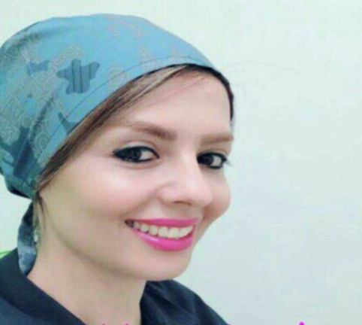
Dr. maedeh ahmadi
Fellow in Infertility
Emam Hospital
Tehran University of Medical Ssciences

Slide 2
Ovarian tissue cryopreservation for fertility preservation: clinical and research perspectives
Human reproduction open,pp,1-9,2017

Slide 3
Introduction
Advances in treatment of many cancers with consequent dramatic improvements in long-term survival have led to increasing awareness of the issues
. Amongst medical issues, the potential effects on fertility are an important concern of young women facing therapy for cancer and other conditions treated with similar chemotherapeutic.
The most common cancers in girls and young women are those of the breast, cervix, central nervous system, leukaemias and lymphomas.
Ovarian tissue cryopreservation is one of several options available for female fertility preservation, together with oocyte and embryo

Slide 4
Other approaches include : GnRH analogues, and surgical transposition of the ovary to reduce the radiation dose
This review will focus on ovarian tissue cryopreservation including issues surrounding patient selection, presence of malignant cells contaminating the cryopreserved tissue.
cryopreservation of ovarian tissue was first demonstrated in a series of experiments in the sheep where autografts of cryopreserved ovarian cortex were sutured on to the ovarian pedicle, (Baird et al., 1999).
These key experiments demonstrated which is that the majority of primordial follicles in the cryopreserved tissues do not survive. This is thought to be due to ischaemia prior to evascularization of the graft rather than direct cryo-damage and there is, as yet, no clear way of markedly improving this.

Slide 5
The advent of vitrification, which has transformed the cryopreservation of mature oocytes, may offer some advantages in reducing the cryodamage that does and indeed has been successfully used clinically in this context, but it does not address the problem of revascularization.
One approach to that problem is the cryopreservation of the whole ovary with subsequent vascular re-anastomosis, and whilst there have been developments towards successful use of this approach in animal models .it remains some way from clinical practice.

Slide 6
Search Methods
We reviewed the English-language literature on ovarian tissue cryopreservation and IVM of ovarian follicles using conventional search methods.

Slide 7
When and for whom is ovarian tissue cryopreservation appropriate?
Part of the evidence base relevant to :US Childhood Cancer Survivor Study (CCSS) which has for many years published analyses of reproductive outcomes in a cohort of cancer survivors using their siblings as the control group.
A recent report from this study analysed chemotherapy exposures in relation to the prevalence of pregnancy and live birth in women who had been exposed to chemotherapy: females who had received cranial or pelvic radiotherapy were excluded from this analysis.
The overall hazard ratio for pregnancy was 0.87 (95% CI: 0.81–0.94) compared with the control group of their siblings, demonstrating that most women who have had chemotherapy for cancer treatment in childhood will be able to have children.

Slide 8
Detailed analysis of the particular agents involved identified that alkylating agents were only associated with a decrease in the risk of pregnancy and live birth at the highest doses.
A similar result was reported from a recent analysis of survivors of Hodgkin lymphoma in childhood and adolescence from Germany, in which the overall chance of parenthood of Hodgkin lymphoma survivors was very similar to that of the German population .They showed that procarbazine in cumulative doses up to 11 400 mg/m2 and cyclophosphamide in cumulative doses up to 6000 mg/m2 had no significant or only minor effects on parenthood.
Ovarian tissue cryopreservation for restoration of fertility remains widely regarded as an experimental procedure .although increasing experience with it has led to it becoming established practise in Israel.

Slide 9
To provide a structure for discussions surrounding whether or not to proceed with ovarian tissue cryopreservation, we have developed a risk assessment tool, dividing the key issues into those intrinsic to the patient, and those extrinsic.
The intrinsic factors include whether the patient is well enough to have the necessary laparoscopic surgery to remove ovarian tissue. This should include assessment of coagulation disorders, infection risk, issues regarding the risk of anaesthesia and the potential risk of contamination of ovarian tissue by malignant disease

Slide 10
Assessment of the ovarian reserve using biomarkers such as anti-Müllerian hormone (AMH) or antral follicle count are routinely performed prior to assisted reproduction to predict the patient’s response.
Many studies have shown a reduction in these biomarkers after cancer treatments indicating their potential to quantify ovarian toxicity and distinguish between the effects of different regimens .
Pretreatment levels of AMH have also been shown to predict the risk of amenorrhoea in women subsequently treated with chemotherapy for breast cancer (2011,2014), substantiating the hypothesis that women with a higher ovarian reserve pretreatment are more likely to have ongoing ovarian function thereafter.
It would seem likely that these biomarkers could be used to give some prediction of remaining postchemotherapy ovarian function and reproductive lifespan.

Slide 11
Similar analyses have been performed in healthy women, but accurate prediction of remaining reproductive lifespan seems only poorly predicted by, for example, AMH, except at particularly low levels in younger women (2008; 2013).
The key extrinsic factor is the key risk factors are the administration of whole body, pelvic (or abdominopelvic in children) radiotherapy and high-dose alkylating agents.
The patient’s age is probably the most important determinant of how damaging these therapies are, as reflected in the dramatic increase in risk of amenorrhoea after chemotherapy in women treated for breast cancer with older age at treatment.

Slide 12
However, a significant problem is that even therapies that have low risk, such as the commonly administered ABVD regimen for early stage Hodgkin lymphoma, may have some impact on ovarian function (potentially in those with lower pretreatment ovarian reserve) as women treated with this regimen have recently been shown to have a reduced oocyte.
This also highlights that whereas initial therapy for the primary malignancy may carry a low risk of premature ovarian insufficiency (POI) and infertility, treatment may change depending on initial response and regimens used for relapse will generally carry a high risk.

Slide 13
analysis of ovarian function in a population aged up to 18 years, some of whom were offered ovarian tissue cryopreservation .
Risk of POI : the period of follow-up, of 35% over the 15 year follow-up period (Cryo + ). This contrasted with a prevalence of only 1% (1 individual in a cohort of 141) .
The young age of the population studied precluded the use of fertility as the key outcome but this clearly shows the potential for focussed patient selection.

Slide 14
In contrast, in a relatively unselected population of women who underwent pre-chemotherapy unilateral oophorectomy for fertility preservation, follow-up at a mean of 58 months showed a prevalence of POI of 9% in women with breast cancer, and 18% in those with lymphoma, but 87% of those with leukaemia, reflecting the widespread use of bone marrow transplantation in that group.
Overall, 41 of the 57 women in the group who had tried to conceive had been successful, i.e. a retained fertility rate of72%.

Slide 15
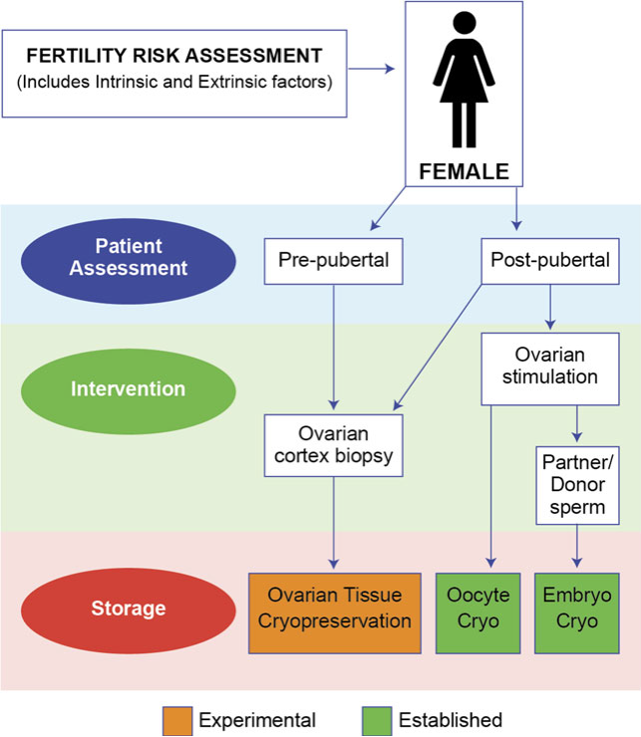

Slide 16
How effective is ovarian tissue cryopreservation?
The first successful pregnancy after replacement of cryopreserved ovarian tissue was reported in 2004 (Donnez et al., 2004) and at present there are ~100 babies born following this procedure, although this number is increasing all the time.
An analysis of 60 tissue replacements carried out in Belgium, Denmark and Spain demonstrated that over 90% of women showed some evidence of ovarian activity, first seen a median of 4 months after transplantation (Donnez et al., 2013). Eighteen per cent of these women achieved a pregnancy, the majority after natural conception, and 12 live births were recorded from 6 women.
The majority of these pregnancies were after natural conception, and the potential for this is one of the key positive aspects of ovarian tissue cryopreservation compared with oocyte or embryo cryopreservation.

Slide 17
Replacement of cryopreserved ovarian tissue purely for hormone production rather than fertility has been proposed.
This may well be appropriate for some women who have completed their family or no longer wish to pursue fertility, taking into account the risk of malignant contamination, the uncertain duration of function of replaced ovarian tissue, and issues surrounding risks and benefits of hormone ‘replacement’ beyond the age of natural menopause.

Slide 18
The risk of malignant contamination
A range of methods specific to the diagnosis can be used to detect malignant contamination, including immunohistochemistry and molecular analysis, and a sample of tissue should be sent for such analysis at the time it is stored.
These tests are all, however, destructive, and therefore cannot be applied to the actual pieces of tissue that will be replaced in the patient.
In general, it is considered that where there is no evidence of metastatic disease of solid cancers, then the risk of ovarian contamination is low.
However, for leukaemias before treatment has started there is a high risk that circulating malignant cells will be present in the ovary, and this has been confirmed in a number of studies specifically investigating this ,
A high level of vigilance is required to detect contamination even when the diagnosis and staging tests indicate a low risk.

Slide 19
The application of ovarian tissue cryopreservation in patients with leukaemia remains controversial because of this risk of contamination.
The benefits and risks of this approach have yet to be clearly quantified and undertaking ovarian tissue cryopreservation in these patients remains contentious.

Slide 20
Developing methodologies to optimize the potential of cryopreserved tissue
Whilst reimplantation of ovarian tissue has been a major advance for fertility preservation, it is not suitable for all patients .
First, isolating follicles from tissue at specific stages of development either before or after cryopreservation, removing any contaminating cells and recombining the follicles within a supportive matrix to form an ‘artificial ovary’ for subsequent reimplantation or in vitro development, and second, developing oocytes from cryopreserved tissue completely in vitro.

Slide 21
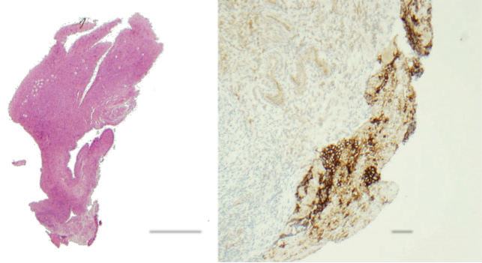
 | 500µM 200µM
Figure 2 Biopsy of ovary from a girl with Ewing’s sarcoma in a verte- bra. A 12-year-old with Ewing’s sarcoma localized to the T7 vertebra and no evidence of metastatic disease underwent ovarian biopsy for fertility preservation. A biopsy sent for pathological examination showed presumed malignant contamination, with CD99 positive cells present consistent with metastatic Ewing’s sarcoma. Left panel, solid arrow indicates area of CD99 positive cells in a haematoxylin and eosin stained section, open arrow indicates primordial follicles in cortex of ovary. Right panel: CD99 (brown stain) immunohistochemistry result. | Figure 2 Biopsy of ovary from a girl with Ewing’s sarcoma in a verte- bra. A 12-year-old with Ewing’s sarcoma localized to the T7 vertebra and no evidence of metastatic disease underwent ovarian biopsy for fertility preservation. A biopsy sent for pathological examination showed presumed malignant contamination, with CD99 positive cells present consistent with metastatic Ewing’s sarcoma. Left panel, solid arrow indicates area of CD99 positive cells in a haematoxylin and eosin stained section, open arrow indicates primordial follicles in cortex of ovary. Right panel: CD99 (brown stain) immunohistochemistry result. | Figure 2 Biopsy of ovary from a girl with Ewing’s sarcoma in a verte- bra. A 12-year-old with Ewing’s sarcoma localized to the T7 vertebra and no evidence of metastatic disease underwent ovarian biopsy for fertility preservation. A biopsy sent for pathological examination showed presumed malignant contamination, with CD99 positive cells present consistent with metastatic Ewing’s sarcoma. Left panel, solid arrow indicates area of CD99 positive cells in a haematoxylin and eosin stained section, open arrow indicates primordial follicles in cortex of ovary. Right panel: CD99 (brown stain) immunohistochemistry result.
Left panel, solid
arrow indicates area of CD99 positive cells in a haematoxylin and eosin
stained section, open arrow indicates primordial follicles in cortex of
ovary.
Right panel: CD99 (brown stain) immunohistochemistry result.

Slide 22
Making an artificial ovary
The aim of developing an ‘artificial ovary’ is to produce a structure that would be free of any potential malignant cells and contain healthy immature follicles (and stromal cells).
Bioengineering has led to the development of many materials to support follicle development. Alginate has given positive results with mouse and human follicles and fibrin has also been demonstrated to be a viable material to support isolated murine primordial follicles after transplantation.

Slide 23
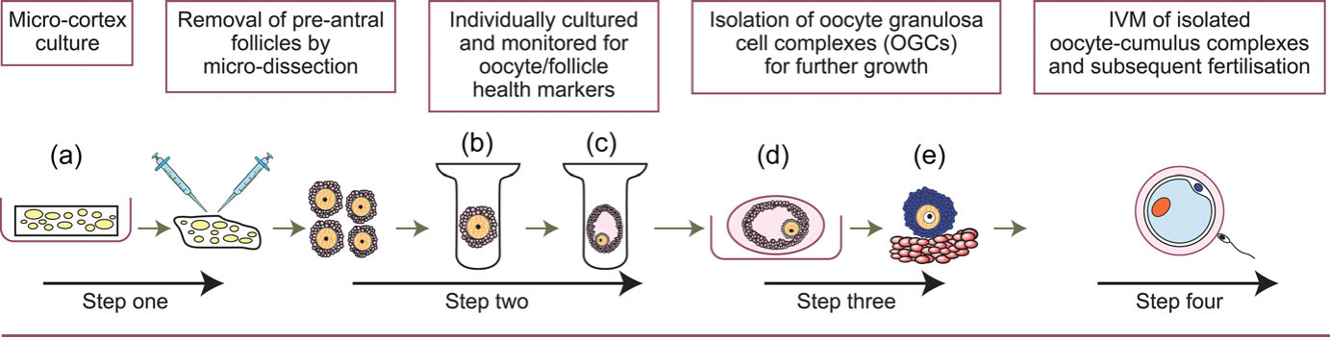
Figure 3 Multistep culture system for activation of human primordial follicles and subsequent follicle/oocyte development. Primordial follicles can be activated or held dormant within ovarian cortical tissue (a). Once activated preantral stages can be isolated (b), they are grown individually to antral stages (c). These can be further grown, for example, within an alginate bead (d) to obtain fully grown oocytes (e), then competence to undergo matur- ation and fertilization is tested. | Figure 3 Multistep culture system for activation of human primordial follicles and subsequent follicle/oocyte development. Primordial follicles can be activated or held dormant within ovarian cortical tissue (a). Once activated preantral stages can be isolated (b), they are grown individually to antral stages (c). These can be further grown, for example, within an alginate bead (d) to obtain fully grown oocytes (e), then competence to undergo matur- ation and fertilization is tested. | Figure 3 Multistep culture system for activation of human primordial follicles and subsequent follicle/oocyte development. Primordial follicles can be activated or held dormant within ovarian cortical tissue (a). Once activated preantral stages can be isolated (b), they are grown individually to antral stages (c). These can be further grown, for example, within an alginate bead (d) to obtain fully grown oocytes (e), then competence to undergo matur- ation and fertilization is tested.
Multistep culture system for activation of human primordial follicles and subsequent follicle/oocyte development.

Slide 24
Oocyte growth and development in vitro using cryopreserved tissue
Growth in vitro from the most immature oocytes (primordial stages) with subsequent IVF and production of live young has only been achieved in mouse .
The complete process of murine oogenesis from the primordial germ cell stage to the production of developmentally competent oocytes can be recapitulated in vitro and the resultant offspring have been shown to be healthy. Whilst there are major differences between human and mouse oocyte development, the mouse work provides proof of concept that complete oocyte development can beachieved in vitro and has driven the development of culture systems that could be applied to other species, particularly human.
A dynamic culture system is required to support the three main transition steps in oocyte/follicle development, i.e. growth activation, ongoing culture of isolated follicles and final oocyte maturation.

Slide 25
In vitro activation of primordial follicles
The regulation of follicle activation involves a combination of inhibitory, stimulatory and maintenance factors.
Work using knockout mouse models has highlighted the importance of the phosphatidylinositol-3′-kinase (PI3K-AKT) signaling pathway within the oocyte in regulating follicle activation .
Using pharmacological inhibitors of phosphatase and tensin homologue in vitro leads to increased activation of human primordial follicles .
whereas treatment with rapamycin (an inhibitor of mammalian target of rapamycin complex 1: mTORC) results in decreased activation .
A human live birth has been reported following the treatment of ovarian tissue for 48 h in vitro with bpV(HOpic) and 740YP, an Akt stimulant, followed by replacement and IVF .
This is an extremely encouraging development but needs to be treated with caution as similar inhibitors in vitro, whilst increasing activation of primordial follicles, result in poor quality oocytes at later stages.

Slide 26
Isolation and culture of growing follicles to achieve oocyte growth and development
Once follicles have reached the multi-laminar preantral stage of evelopment, there are several culture systems that support further growth.
Placing preantral follicles in v-shaped micro-well plates allows maintenance of three-dimensional follicular architecture in vitro whilst promoting growth and differentiation of human follicles with antral formation occurring within 10 days. Follicle encapsulation in alginate hydrogels has also been used to support secondary human.
In the presence of FSH, enzymatically isolated secondary human follicles can differentiate, become steroidogenically active and complete oocyte growth in 30 days and have been shown to be capable of meiotic maturation.

Slide 27
Aspiration and maturation of oocyte cumulus complexes
The final goal of an in vitro system is to produce oocytes that can be fertilized and produce developmentally normal embryos. In order to achieve this, in vitro grown human oocytes need to be meiotically matured in vitro and several groups have made important steps towards this for clinical use over the last two decades.
It is widely accepted that whilst 40–80% of immature human oocytes can successfully complete IVM and fertilization, the rate of maturation of immature oocytes is still well below that of oocytes harvested from stimulated ovaries, indicating that the protocols are suboptimal or many of the harvested oocytes are intrinsically unable to undergo maturation.

Slide 28
Conclusion
Oocyte and embryo cryopreservation are established but in most countries in the world, ovarian tissue cryopreservation remains experimental, particularly in younger adolescents and prepubertal girls. Cryopreservation of ovarian cortical tissue with later replacement has now resulted in at least 100 live birtha

Slide 29
vrhrc.tums.ac.ir
Thank you

